Slide 1

OOP Project
LAHORE GARRISON UNIVERSITY
Names of presenter
Usman Shabbir
Sahar Fatima
laiba perveen
Submitted to : Ma’am Arooj Abid

Slide 2
PAKISTAN POST
1
Pakistan post is committed to make secure and timely delivery of mail, money and material at the doorsteps of the customers at affordable cost.

Slide 3
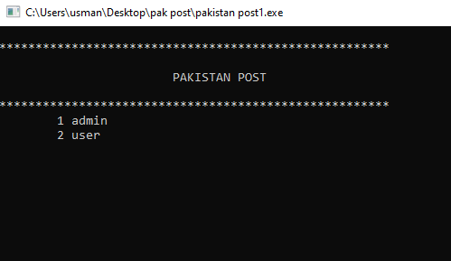
SELECTION
2
ADMIN LOGIN OR
USER LOGIN

Slide 4
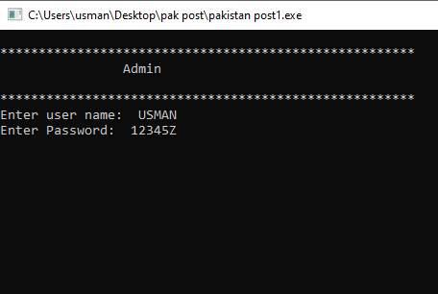
Log in admin
3
First Enter the name “Usman” and password “123452” to login into admin account.
If you don’t enter the above mentioned name and password then you will have to select the option again.

Slide 5
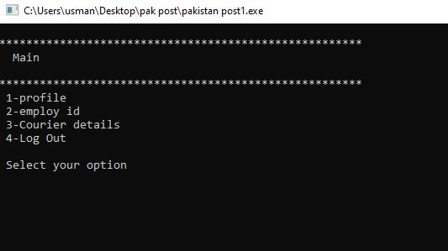
Main
4
When you have logged in to you admin account you will see the following options for your ID:
profile
employee ID
courier details
log out

Slide 6
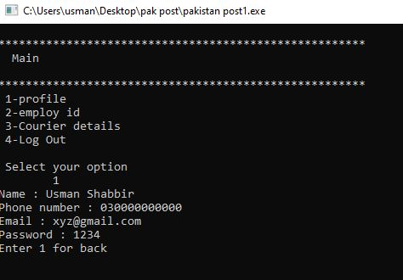
1.Profile login
5
After selecting option 1 you will see the following:
Name : Usman Shabbir
Phone number : 030000000000
Email : xyz@gmail.com
Password : 1234
Enter 1 for back

Slide 7
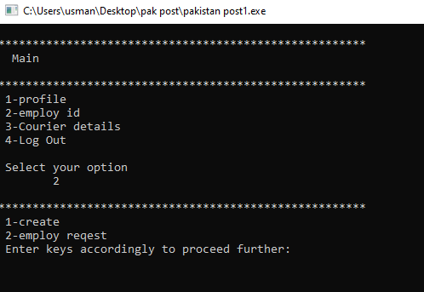
2. Employee ID
6
If you are selecting option 2 to view employee ID you will get the following options for your ID:
1-create
2-employ request
Enter keys accordingly to proceed further:

Slide 8
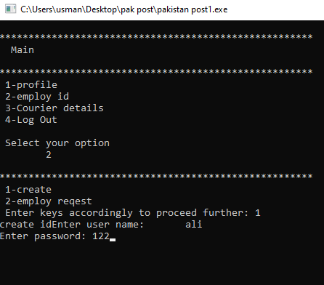
1. Create
7
Create id of employ
User name
Password

Slide 9
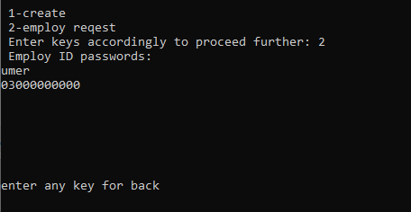
2. Employ request
8
Employ requests forget password
Employ id
Employ number

Slide 10
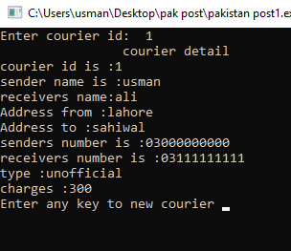
3. Courier Detail:
9
Enter courier id : 1
Courier detail :
Courier I'd is :
Sender name is :
Receiver name is :
Address from :
Address to :
Sender number is :
Receiver number is :
type :
Courier charges :
1 confirm

Slide 11
4.Log out
10
Go back to main menu
Select again

Slide 12
SELECTION
11
ADMIN LOGIN OR
USER LOGIN

Slide 13
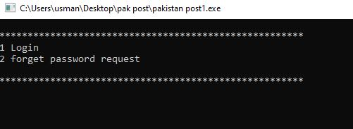
2. User
12
If you are selecting option 2 you will get the following options:
1-login
2-forget password request
Enter keys accordingly to proceed further.

Slide 14
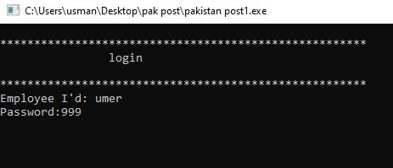
1.Login:
13
First Enter the name “umer” and password “999” to login into user account.
If you don’t enter the above mentioned name and password then you will have to select the option again.

Slide 15
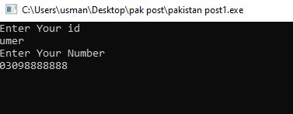
2.Forget password request:
14
First Enter the name
Enter your number
Which send to admin

Slide 16
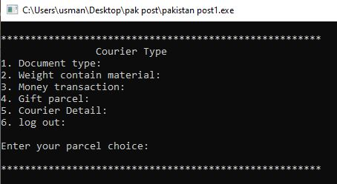
Courier Type:
15
After login in user account you will ask to tell your courier type:
Document type:
Weight contain material:
Money transaction:
Gift parcel:
Courier Detail:
log out:
Enter your parcel choice:

Slide 17
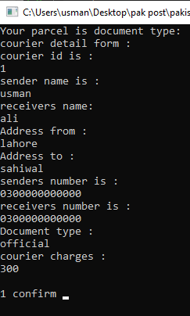
1.Document type:
16
Your parcel is document type :
Courier detail form :
Courier I'd is :
Sender name is :
Receiver name is :
Address from :
Address to :
Sender number is :
Receiver number is :
Document type :
Courier charges :
1 confirm

Slide 18
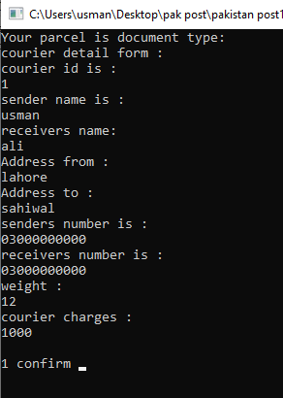
2. Weight contain material:
17
Your parcel is document type :
Courier detail form :
Courier I'd is :
Sender name is :
Receiver name is :
Address from :
Address to :
Sender number is :
Receiver number is :
Weight :
Courier charges :
1 confirm

Slide 19
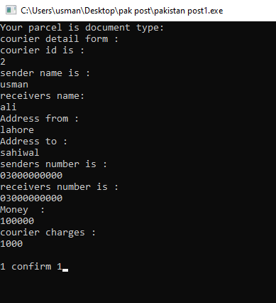
3. Money transaction:
18
Your parcel is document type :
Courier detail form :
Courier I'd is :
Sender name is :
Receiver name is :
Address from :
Address to :
Sender number is :
Receiver number is :
Money :
Courier charges :
1 confirm

Slide 20
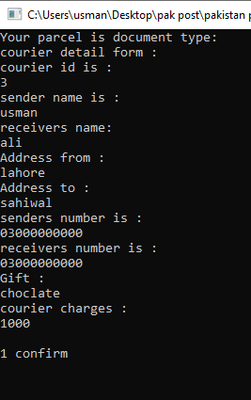
4. Gift parcel:
19
Your parcel is document type :
Courier detail form :
Courier I'd is :
Sender name is :
Receiver name is :
Address from :
Address to :
Sender number is :
Receiver number is :
Gift :
Courier charges :
1 confirm

Slide 21
5. Courier Detail:
20
Enter courier id : 1
Courier detail :
Courier I'd is :
Sender name is :
Receiver name is :
Address from :
Address to :
Sender number is :
Receiver number is :
type :
Courier charges :
1 confirm

Slide 22
6.Log out
21
Go back to main menu
Select again

Slide 23
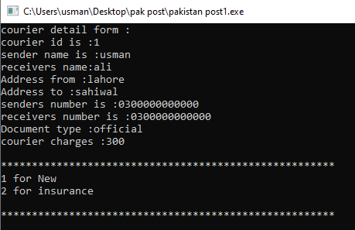
Insurance
22
User choice will be asked if the choice is 1 Courier will appear if the choice is 2 insurance form will appear.

Slide 24
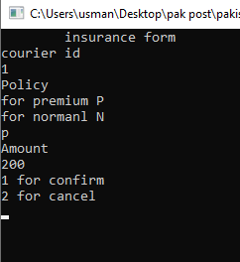
Insurance form
23
In the insurance form there is courier id, policy, and amount.
The user will be asked for confirming or cancel.
If the user goes for confirm option in insurances go back to main menu.

